Slide 1
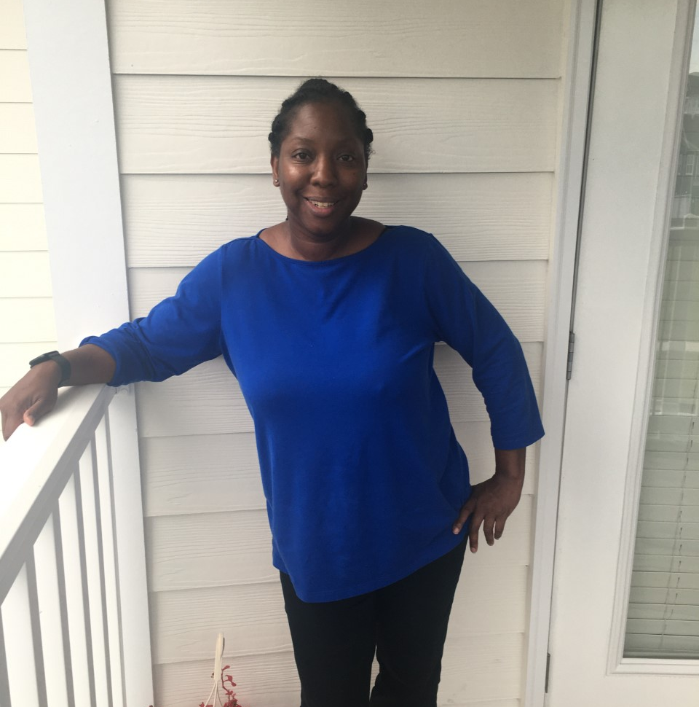
Ms. Ronda Tankersley
EDUCATION
B.S. – University of Phoenix
M.S. – Capella University
BELIEF STATEMENT
“Tell me and I forget. Teach me and I remember. Involve me and I learn.” – Benjamin Franklin
CONTACT INFORMATION
Email: TankeRo@boe.Richmond.k12.ga.us
Dojo: https://classdojo.com/invite/?c=CNHTKU2
1st Grade Teacher

